Slide 1
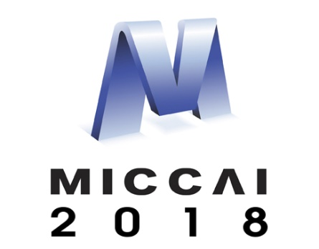
Semi-automated pipeline for neuroimaging PET/MR visualization and quantification
MICCAI Educational Challenge 2018
By Fabio Raman, University of Alabama at Birmingham
Mentors: Jon McConathy, MD, PhD and Erik Roberson, MD, PhD

Slide 2
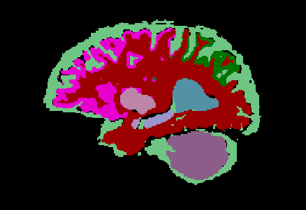
Quantification of PET/MR biomarkers requires several steps
Brain segmentation of volumetric MR image
Image registration of MR to PET
Extraction of volumes of interest (VOI)
Quantification of biomarkers

Slide 3
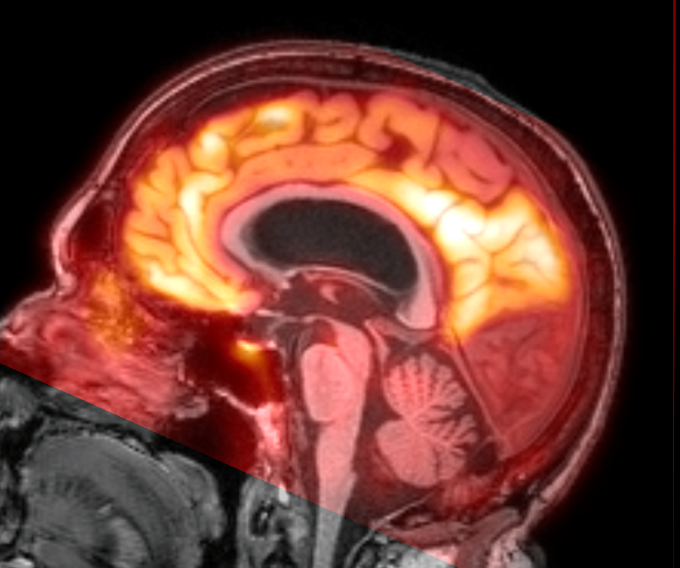
Quantification of PET/MR biomarkers requires several steps
Brain segmentation of volumetric MR image
Image registration of MR to PET
Extraction of volumes of interest (VOI)
Quantification of biomarkers

Slide 4
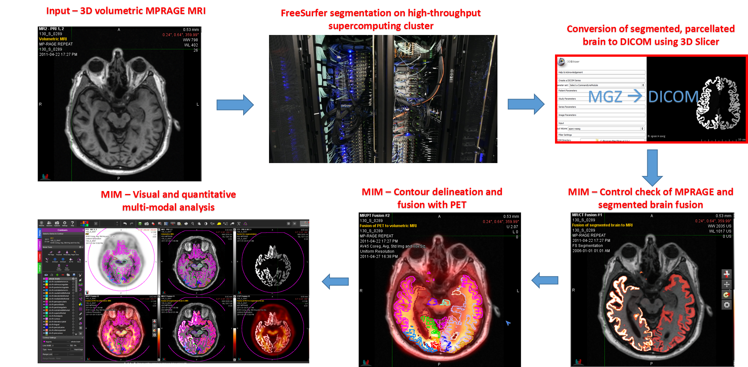
Quantification of PET/MR biomarkers requires several steps
Brain segmentation of volumetric MR image
Image registration of MR to PET
Extraction of volumes of interest (VOI)
Quantification of biomarkers

Slide 5

Quantification of PET/MR biomarkers requires several steps
Brain segmentation of volumetric MR image
Image registration of MR to PET
Extraction of volumes of interest (VOI)
Quantification of biomarkers
$$SUVR=\frac{{SUV}_{target region}}{{SUV}_{cerebellar GM}}$$

Slide 6
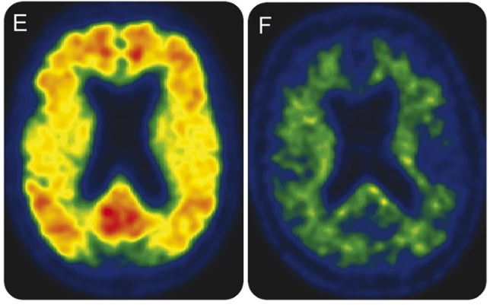
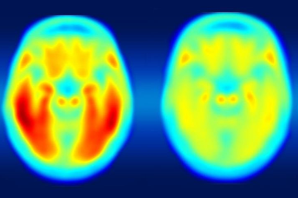

Why is it important to combine visualization with quantification?
Current FDA guidelines still use visual criteria to assess status of patients with various imaging biomarkers
Example: Alzheimer’s disease assessment using neuroimaging according to NIA-AA guidelines for Aβ plaques (A), tau tangles (T), and neurodegeneration (N)
:
A+
A-
T+
T-
N+
N –

Slide 7
Problems with current processing pipelines
None have been implemented into routine clinical workflow
  No FDA approval
  Computational intensive
  Time consuming
  No visualization
Issues with fully automated registration methods
  Lack of visual control check to ensure accurate contour delineation across modalities
Lack of versatility
  Not adaptable to different segmentation algorithms
  Important for multicenter trials and longitudinal studies

Slide 8
Methods – Multimodal Brain Processing Pipeline (MMBP)

Slide 9
Methods – Multimodal Brain Processing Pipeline (MMBP)

Slide 10
Methods – Multimodal Brain Processing Pipeline (MMBP)

Slide 11
Methods – Multimodal Brain Processing Pipeline (MMBP)

Slide 12
Methods – Multimodal Brain Processing Pipeline (MMBP)

Slide 13
Methods – Multimodal Brain Processing Pipeline (MMBP)

Slide 14
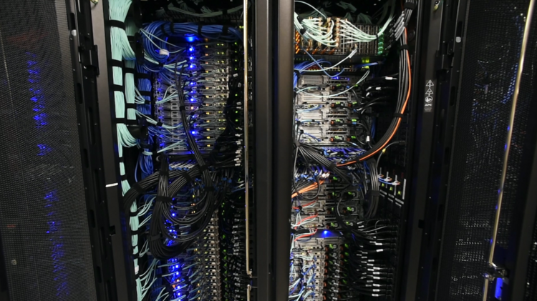
Benefits of using supercomputing cluster
UAB Super Computer (High Performance Computing Cluster) Cheaha
3120 CPU cores that provide over 120 TFLOP/s of combined computational performance.
20 TB of memory

Slide 15
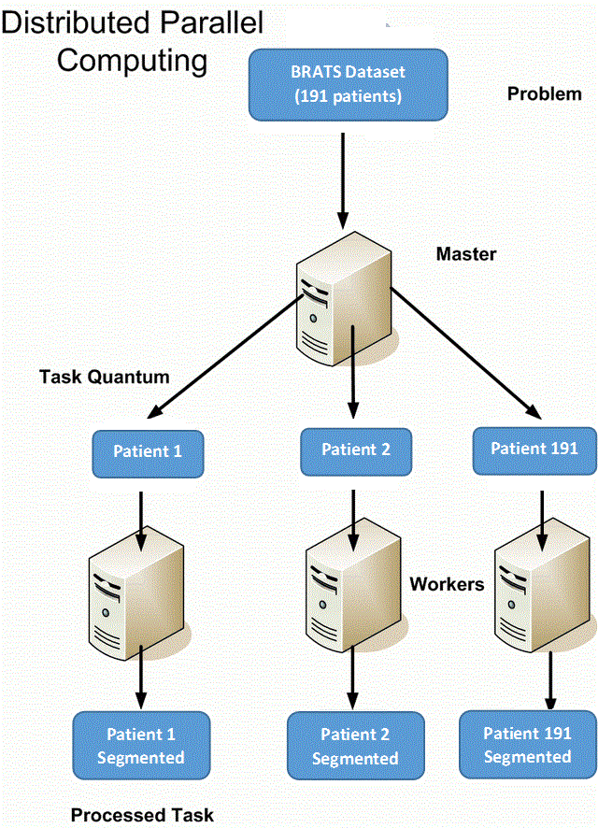
Parallel and distributed implementation
Every patient (1 volumetric MRI) was sent to 1 node in Cheaha Cluster
It took about 8 hours to segment 1 patient
~200 patients were segmented in less than 12h.

Slide 16
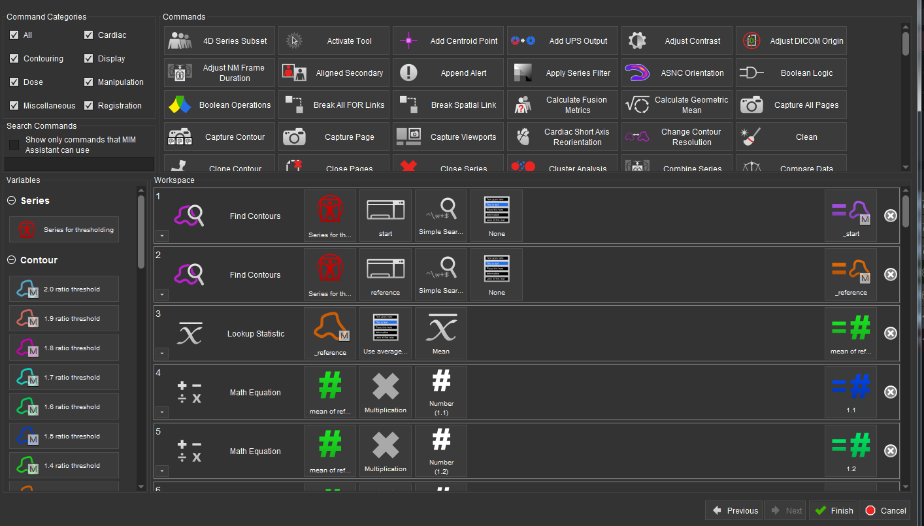
Benefits of using MIM
Easy, efficient to design workflows encompassing a wide of array of post-processing tools to automate analysis

Slide 17
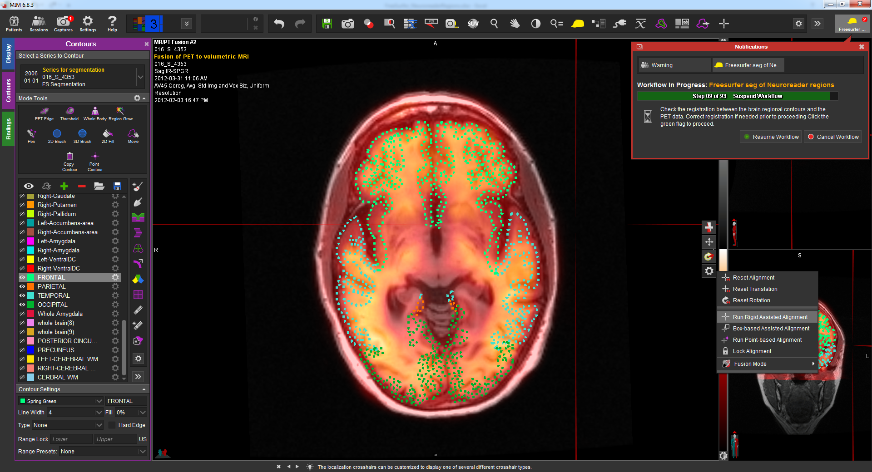
Manual editing of contours and registration, if necessary, to ensure accuracy

Slide 18
Manual editing of contours and registration, if necessary, to ensure accuracy
Contour editing tools

Slide 19
Manual editing of contours and registration, if necessary, to ensure accuracy
Contour editing tools
Outlined brain regions

Slide 20
Manual editing of contours and registration, if necessary, to ensure accuracy
Contour editing tools
Outlined brain regions
Registration tools

Slide 21
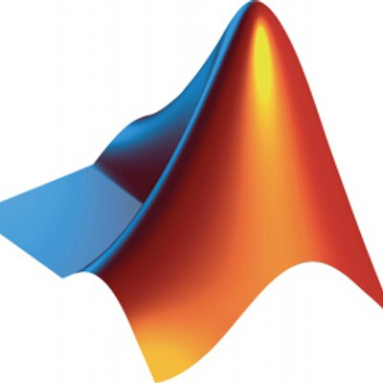
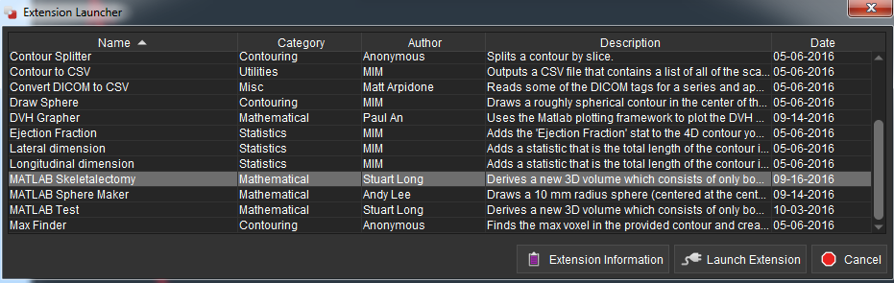
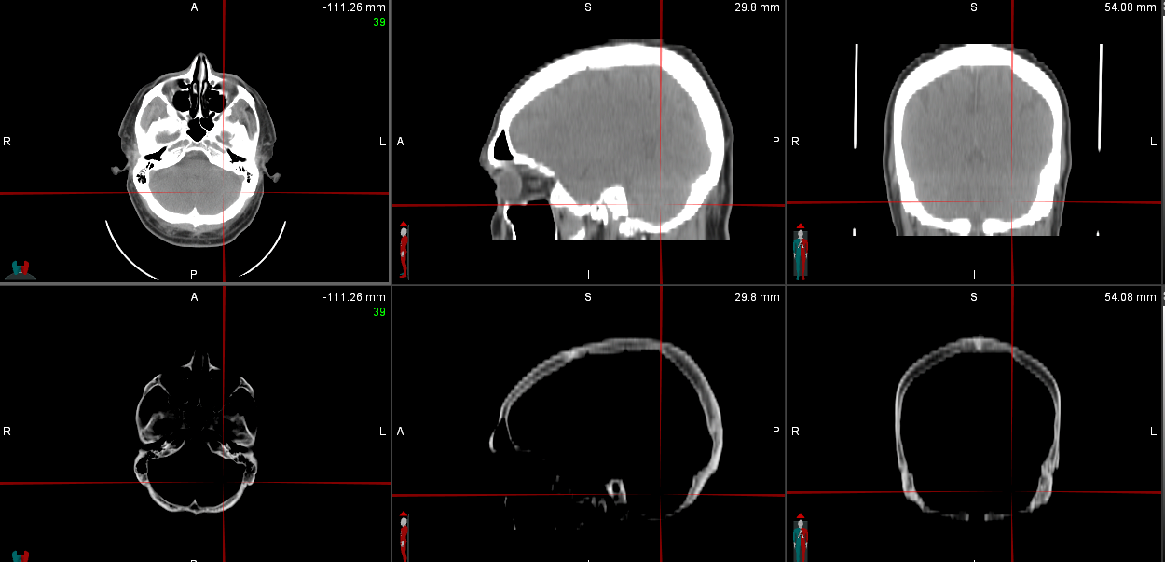
No limits to customized analysis with ability to imbed Matlab extensions into workflow
Extension has adjusted new CT image so that all values less than bone are replaced by air

Slide 22
Conclusions
Semi-automated pipelines PET/MR allows for streamlined neuroimaging analysis for both clinical and research use
Key features
  Efficient and easy for physicians to use
  Automatically segments VOIs with high accuracy and reproducibility
  FDA-approved with visualization
  Versatile
    Implemented with wide array of segmentation algorithms, biomarkers, and diseases

